Slide 1


FINANCIAL
REPORTING
Yahshaswitha Sirineni

Slide 2
AGENDA
01
05
INTRODUCTION
ACCOUNTING STANDARDS
02
06
OBJECTIVES
CHALLENGES
03
07
COMPONENTS
RECENT DEVELOPMENTS
04
FINANCIAL REPORTING PROCESS
08
CONCLUSION

Slide 3
Financial reporting refers to the process of disclosing a company's financial performance and position to various stakeholders.
It provides a comprehensive picture of a company's financial health and is crucial for decision-making.
INTRODUCTION
Financial reports include income statements, balance sheets, cash flow statements, and accompanying footnotes.

Slide 4





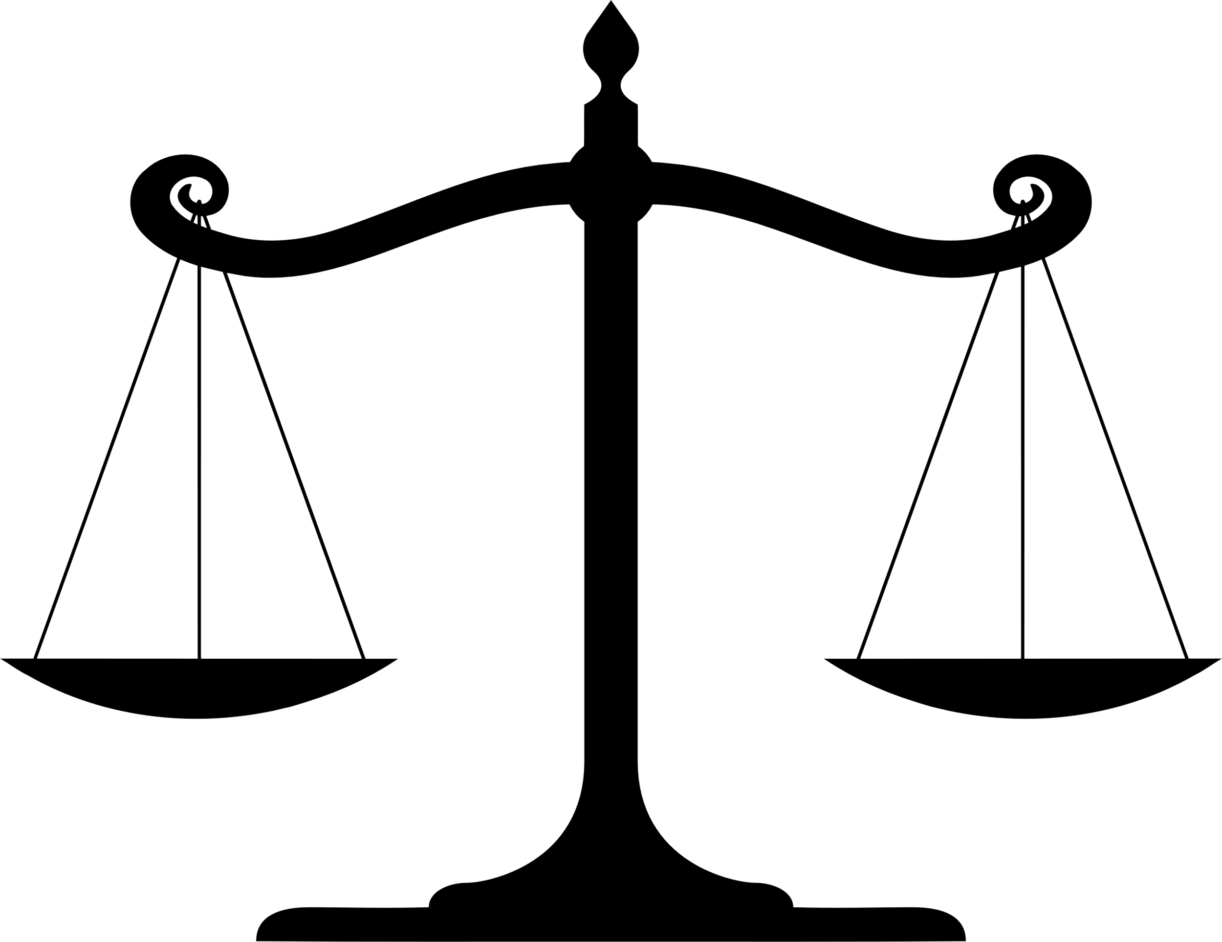
OBJECTS OF FINANCIAL PERFORMANCE
HISTORICAL
RECORDS AND
FORECASTING
PERFORMANCE
EVALUATION
ASSESMENT OF FINANCIAL
POSITION
DECISION
MAKING
TRANSPARENCY
AND
ACCOUNTABILITY
COMPLIANCE
AND
REGULATION

Slide 5
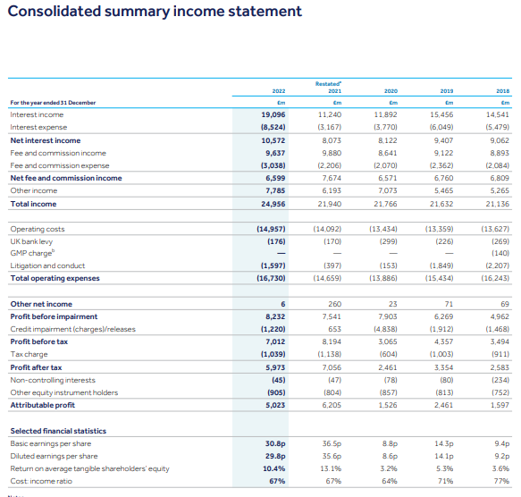
KEY COMPONENTS OF FINANCIAL REPORTS
INCOME
STATEMENT
Also known as profit and loss statement. Shows a company's revenues, expenses, and profits over a specific period.
BALANCE
SHEET
Also known as Statement of Financial Position. Presents a snapshot of a company's assets, liabilities, and shareholder's equity at a specific date.
CASH FLOW
STATEMENT
Highlights the cash inflows and outflows from operating, investing, and financing activities.

Slide 6
THE FINANCIAL REPORTING PROCESS
Review and Analysis
Financial Statement Preparation
Data Collection and Recording
Management and auditors review the statements for accuracy and compliance.
Accountants organize and summarize the data into financial statements.
Companies gather financial
data from various sources, such as transactions, invoices, and receipts.

Slide 7



ACCOUNTING STANDARDS
International Financial Reporting Standards (IFRS)
Generally Accepted Accounting Principles (GAAP)
These are set of accounting rules for the financial statements that are globally recognized and is developed by by IASB.
It is a framework of accounting standards, principles and procedures used in the United States to guide financial reporting.

Slide 8






CHALLENGES
Compliance with Accounting Standards
Data Accuracy and Integrity
Timeliness of reporting
Technology and Software
International Operations
Auditing and Assurance

Slide 9



RECENT DEVELOPMENTS
01
Automation and Artificial Intelligence
02
Integrated Reporting
03
Blockchain in Financial Reporting

Slide 10

CONCLUSION
Financial reporting is an essential process that involves recording summarizing and presenting a company's financial information to external stakeholders. Through adherence to accounting standards and independent auditing, financial reporting promotes transparency, accountability, and trust in the business world, contributing to a robust and reliable financial ecosystem. It fosters trust, aids decision-making, and ensures companies remain accountable.

Slide 11

Up for some queries?
Yahshaswitha Sirineni
Intern
Risk Finance and Treasury
Go ahead!!

Slide 12
Cheers!!
to the hard work and experience

